Slide 1
数据挖掘与统计计算
总共3学分
平时40%和期末60%
平时：3次小作业
期末：考试周闭卷考试
有问题的话发邮件 qinlei@uibe.edu.cn 预约
答疑时间每周四 下午1点到5点，诚信楼730

Slide 2
chapter 1 InTRODUCTIOn

Slide 3
An Overview of Statistical Learning
Statistical learning refers to a vast set of tools for understanding data. These tools can be classified as supervised or unsupervised.
Supervised learning：regression and classification
Unsupervised learning: clustering and dimension reduction

Slide 4
Wage data(for regression)
In this application, we examine a number of factors that relate to wages for a group of males from the Atlantic region of the United States.
In particular, we wish to understand the association between an employee’s age and education, as well as the calendar year, on his wage.

Slide 5
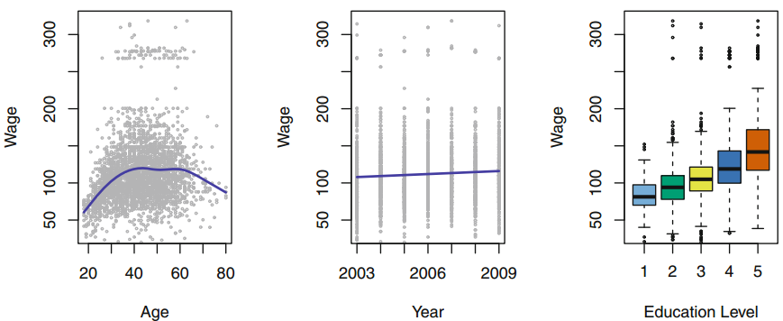

Slide 6
Stock Market Data(for classification)
we examine a stock market data set that contains the daily movements in the Standard & Poor’s 500 (S&P) stock index over a 5-year period between 2001 and 2005.
The goal is to predict whether the index will increase or decrease on a given day using the past 5 days’ percentage changes in the index.

Slide 7
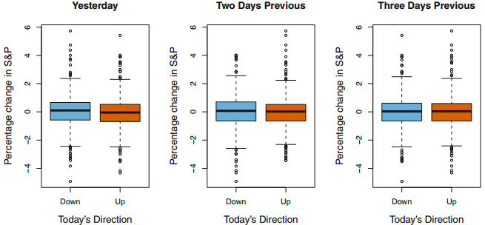

Slide 8
Gene Expression Data (for clustering)
We consider the NCI60 data set, which consists of 6,830 gene expression measurements for each of 64 cancer cell lines.
we are interested in determining whether there are groups, or clusters, among the cell lines based on their gene expression measurements.

Slide 9
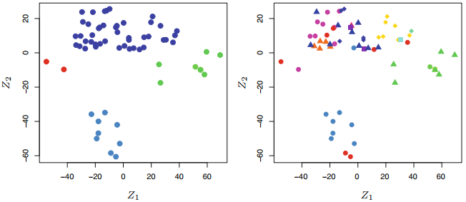

Slide 10
A Brief History of Statistical Learning
Linear regression
Linear discriminant analysis
Generalized linear models
Non-linear method
Classification and regression trees
Generalized additive models
Machine learning
……

